Slide 1

Boosting Supply Chain by Reducing Stockouts and Delays

Slide 2


Introduction
Problem Statement
Stockouts and shipping delays disrupt the supply chain, leading to lost sales, dissatisfied customers, and reduced profitability. Without proactive risk mitigation, high-revenue products and key suppliers remain vulnerable, threatening overall supply chain value.
Objective
To identify and prioritize risks of stockouts and delays using data-driven analysis, delivering actionable strategies to enhance supply chain efficiency and maximize value.
Dataset Information
The dataset contains 25 features, including product details (e.g., 'Product type', 'SKU', 'Price'), inventory metrics (e.g., 'Stock levels', 'Availability', 'Order quantities'), sales and revenue data (e.g., 'Number of products sold', 'Revenue generated'), and supply chain specifics (e.g., 'Production Date', 'Shipping Date', 'Lead times', 'Supplier name', 'Shipping costs'), across 7324 unique product entries.

Slide 3
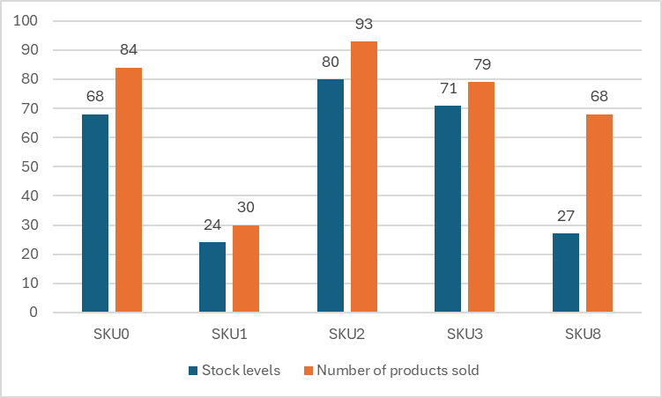
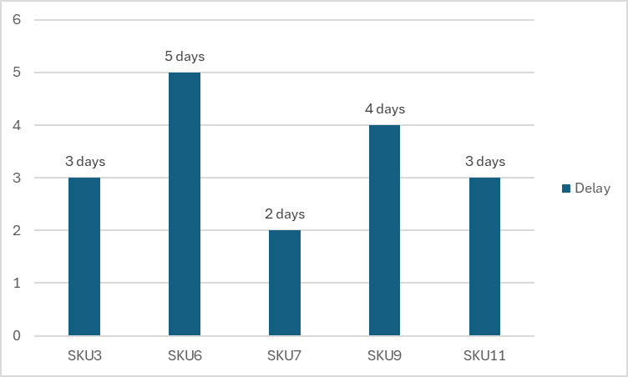
Risk Assessment - Identifying Vulnerabilities
Products which are at shortage risk can be found by comparing stock levels with number of products sold.
Delay in delivering can be found by comparing production date, shipping date and lead times.

Slide 4

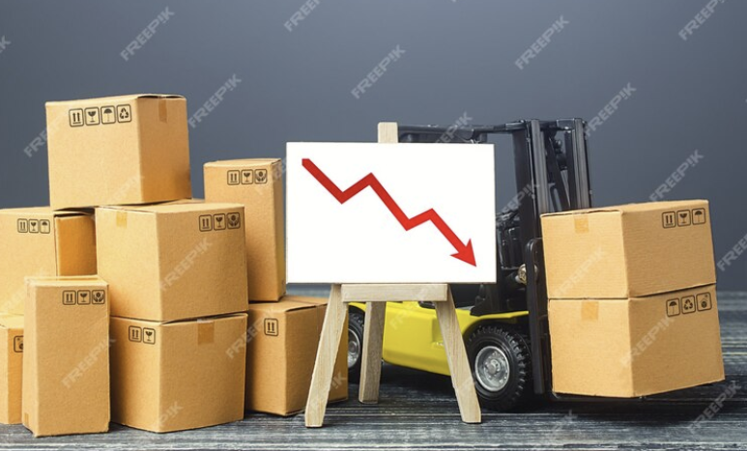
Products At Risk - Stock Availability
Definition
Products at Risk - Availability drops below 80%
An availability of 0.7 means only 70% of the demand was met.
Key Statistic
181 products are at risk of running out.
These 180 products represent only 2% of total inventory but generates a total revenue of 1 million dollars.
SKU [Stock Keeping Unit] | Stock levels | Availability | Revenue generated
SKU22 | 70 | 0.7924 | 2390.8079
SKU107 | 86 | 0.7897 | 9417.2152
SKU157 | 20 | 0.7978 | 5696.8164
SKU225 | 37 | 0.7753 | 3076.0145
SKU268 | 73 | 0.7705 | 9559.779

Slide 5
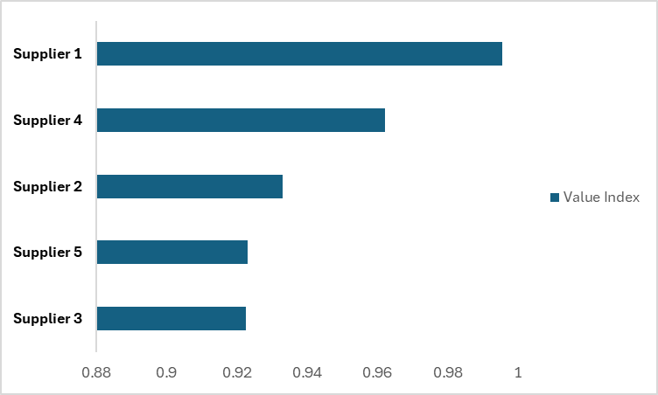
Supplier Value Index - Evaluating Partners
Value Index : A measure to calculate score for an item or a service using performance and importance.
Importance : Revenue contribution relative to the top supplier.
Performance : Revenue minus Manufacturing costs scaled using the top supplier revenue.
Value Index : Importance multiplied by Performance

Slide 6


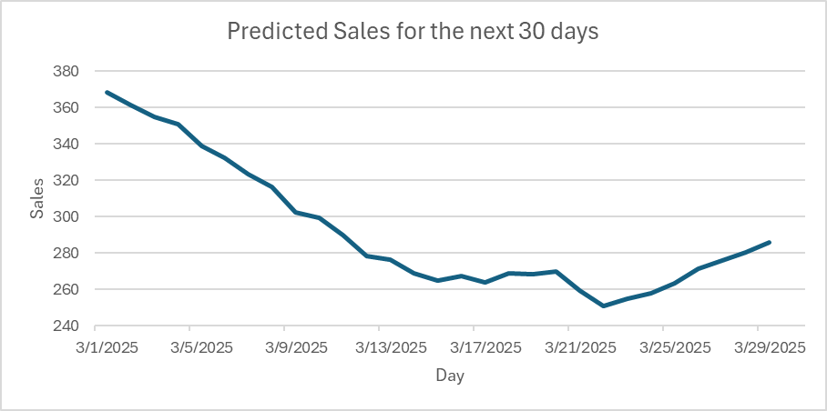
Demand Forecasting - Looking Ahead
Method
Forecasted demand using a 30-day moving average of daily sales.
Each predicted value is the average of last 30 day sales.

Slide 7
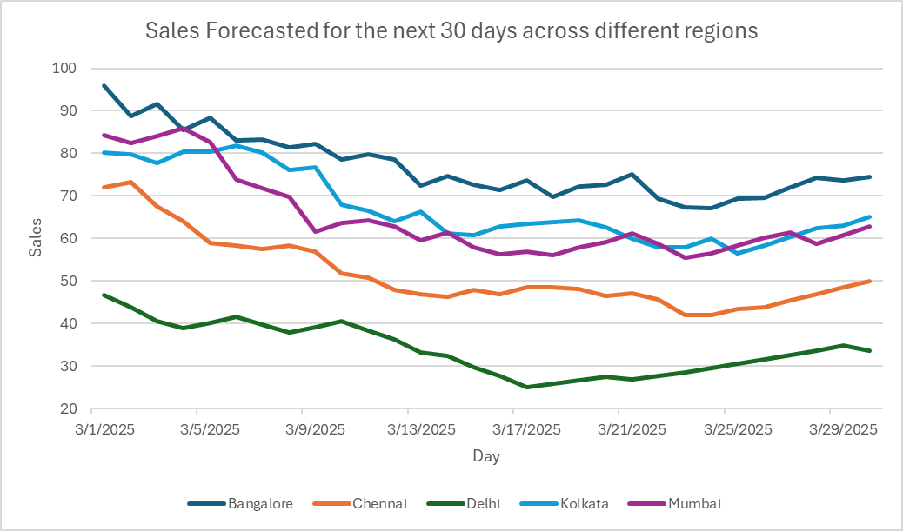
Regional Demand Insights
Broke down demand by region using a pivot of Production Data and Location, then applied a 30-day moving average to forecast the next 30 days.

Slide 8


Key Insights - Connecting the Dots
2% of high-revenue products face shortage risks.
Delays impact top earners, costing $1.6 million in potential revenue.
Supplier 1 stands out with a Value Index closer to 1.
Sales are starting to increase by the end of March.
Regional demand varies, with Banglore peaking in March.

Slide 9
Recommendations - Mitigating Risks
Increase stock reserve for high revenue products.
Accelerate production time for top earned products.
Improve the relationship with the most valued supplier.
Prepare for the upcoming sales by increasing the inventory.
Give more priority to Banglore when the sales are at peak.

Slide 10

Thank You

